Slide 1
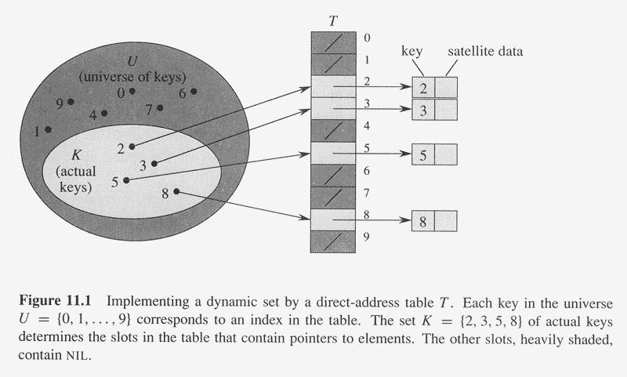
Hash Tables:

Slide 2
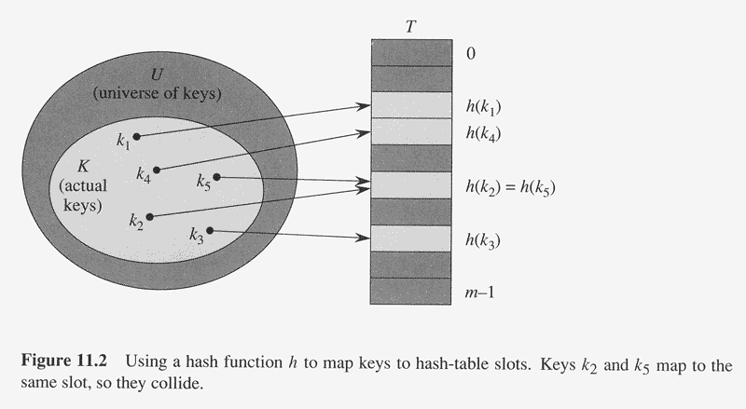
Copyright © The McGraw-Hill Companies, Inc. Permission required for reproduction or display.

Slide 3
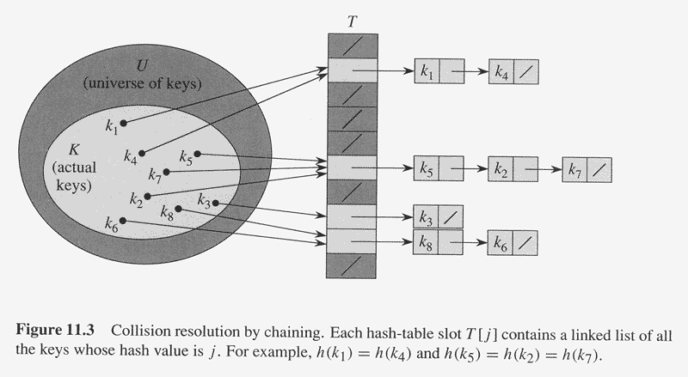
Copyright © The McGraw-Hill Companies, Inc. Permission required for reproduction or display.

Slide 4
Analysis of hashing with chaining:
Given a hash table with m slots and n keys, define load factor = n/m : average number of keys per slot.
Assume each key is equally likely to be hashed into any slot: simple uniform hashing (SUH).

Slide 5
Thm: In a hash table in which collisions are resolved by chaining, an unsuccessful search takes expected time Θ(1+ ) under SUH.
Proof:
Under the assumption of SUH, any un-stored key is equally likely to hash to any of the m slots.
The expected time to search unsuccessfully for a key k is the expected time to search to the end of list T[h(k)], which is exactly .
Thus, the total time required is Θ(1+ ). □

Slide 6
Thm: In a hash table in which collisions are resolved by chaining, a successful search takes time Θ(1+ ), on the average under SUH.
Proof:
Let the element being searched for equally likely to be any of the n elements stored in the table.
The expected time to search successfully for a key.
Elements before x in the list were inserted after x was inserted.
We want to find the expected number of elements added to x’s list after x was added to the list.
....
x
....

Slide 7
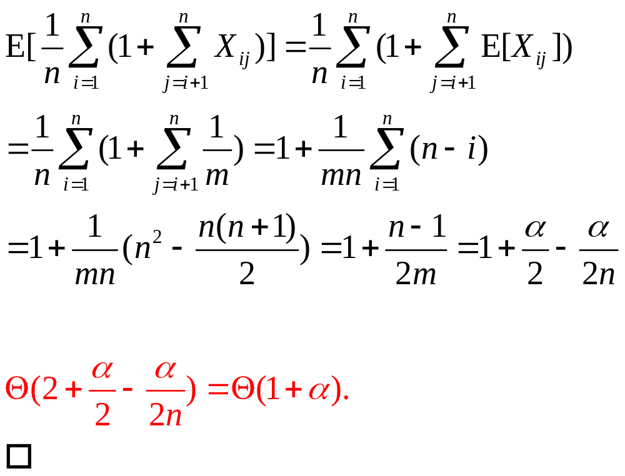
Let x_{i} denote the ith element into the table, for i =1 to n, and let k_{i}=key[x_{i}].
Define X_{ij} = I{ h(k_{i})=h(k_{j}) }. Under SUH, we have Pr{ h(k_{i})=h(k_{j}) } = 1/m = E[X_{ij} ].

Slide 8
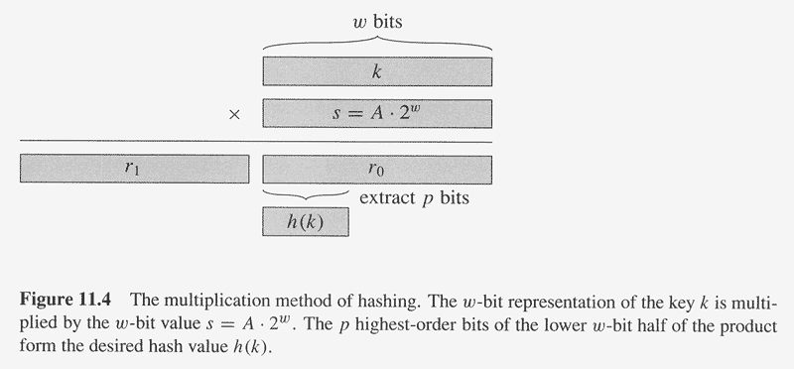
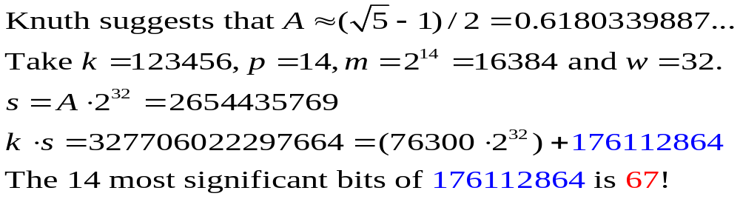
Copyright © The McGraw-Hill Companies, Inc. Permission required for reproduction or display.
The multiplication method:
0<A<1

Slide 9

Universal Hashing
H={ h: U→{0,…,m-1} }, which is a finite collection of hash functions.
H is called “universal” if for each pair of distinct keys k, ∈ U, the number of hash functions h∈H for which h(k)=h( ) is at most |H|/m
Define n_{i} = the length of list T[i]
Thm:
suppose h is randomly selected from H, using chaining to resolve collisions. If k is not in the table, then E[n_{h(k)}] ≤ α. If k is in the table, then
E[n_{h(k)}] ≤ 1+α

Slide 10
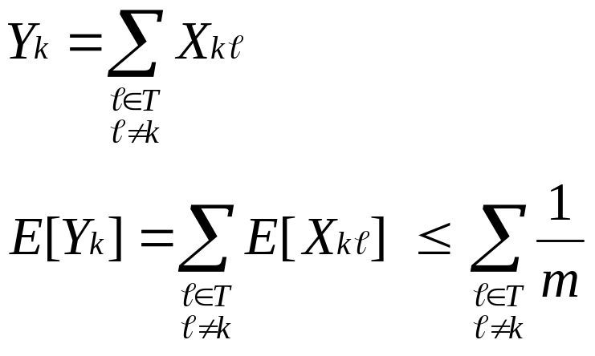
Proof:
  For each pair k and of distinct keys,
  define X_{k} =I{h(k)=h( )}.
  By definition, Pr_{h}{h(k)=h( )} ≤ 1/m, and so
  E[X_{k} ] ≤ 1/m.
  Define Y_{k} to be the number of keys other than k that hash to the same slot as k, so that

Slide 11
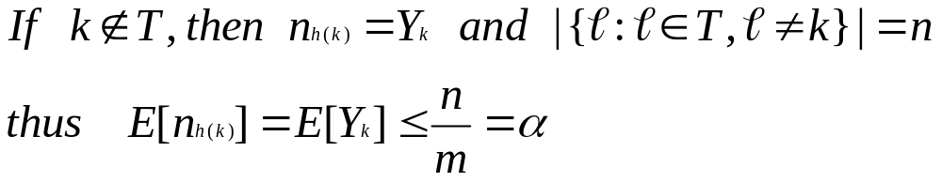
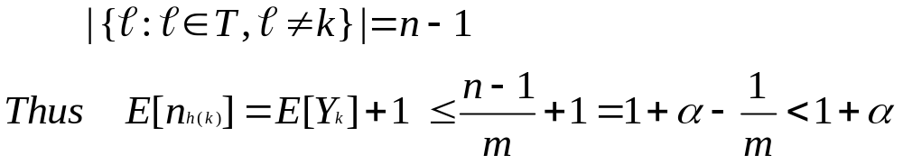
  If k∈T, then because k appears in T[h(k)] and the count Y_{k} does not include k, we have n_{h(k)} = Y_{k} + 1
  and

Slide 12
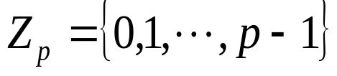
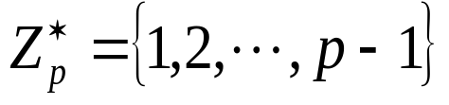
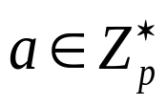
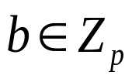
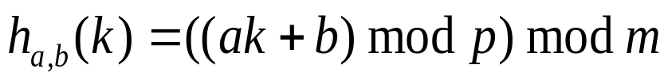
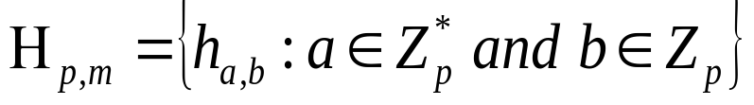
Designing a universal class of hash functions:
p:prime
For any and , define
, h_{a,b}:Z_{p}→Z_{m}

Slide 13
Theorem:
H_{p,m} is universal.
Pf: Let k, be two distinct keys in Z_{p}.
Given h_{a,b}, Let r=(ak+b) mod p , and
s=(a +b) mod p.
Then r-s≡a(k- ) mod p

Slide 14
For any h_{a,b}∈H_{p,m}, distinct inputs k and map to distinct r and s modulo p.
Each possible p(p-1) choices for the pair (a,b) with a≠0 yields a different resulting pair (r,s) with r≠s, since we can solve for a and b given r and s:
a=((r-s)((k- )⁻¹ mod p)) mod p
b=(r-ak) mod p

Slide 15
There are p(p-1) possible pairs (r,s) with r≠s, there is a 1-1 correspondence between pairs (a,b) with a≠0 and (r,s), r≠s.

Slide 16
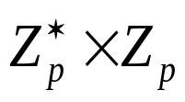
For any given pair of inputs k and , if we pick (a,b) uniformly at random from
, the resulting pair (r,s) is equally likely to be any pair of distinct values modulo p.

Slide 17
Pr[ k and collide]=Pr_{r,s}[r≡s mod m]
Given r, the number of s such that s≠r and s≡r (mod m) is at most
⌈p/m⌉-1≤((p+m-1)/m)-1
=(p-1)/m
∵ s, s+m, s+2m,…., ≤p

Slide 18
Thus,
Pr_{r,s}[r≡s mod m] ≤((p-1)/m)/(p-1)
=1/m
Therefore, for any pair of distinct
k, ∈Z_{p},
Pr[h_{a,b}(k)=h_{a,b}( )] ≤1/m,
so that H_{p,m} is universal.

Slide 19
Open addressing:
  There is no list and no element stored outside the table.
  Advantage: avoid pointers, potentially yield fewer collisions and faster retrieval.

Slide 20
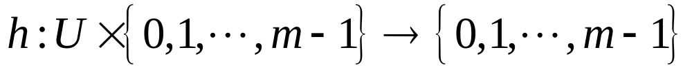
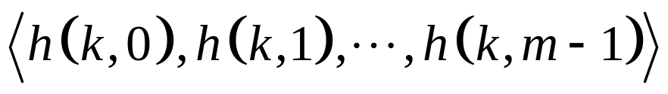
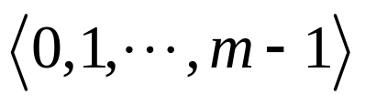
  For every k, the probe sequence
is a permutation of .
  Deletion from an open-address hash table is difficult.
  Thus chaining is more common when keys must be deleted.

Slide 21
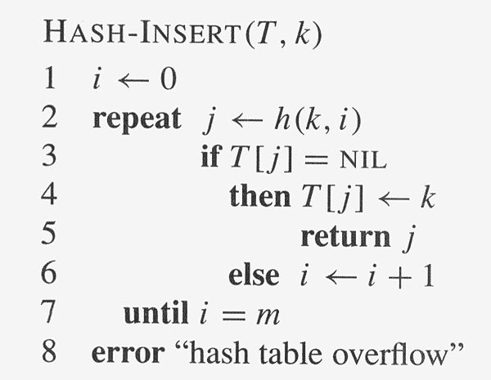
Copyright © The McGraw-Hill Companies, Inc. Permission required for reproduction or display.

Slide 22
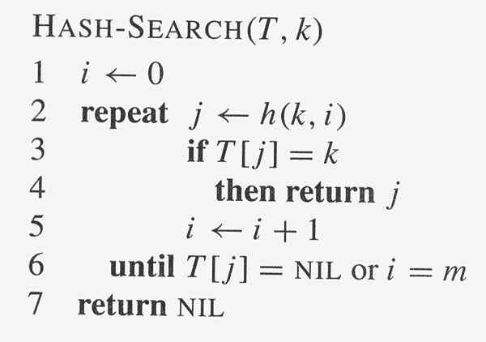
Copyright © The McGraw-Hill Companies, Inc. Permission required for reproduction or display.

Slide 23
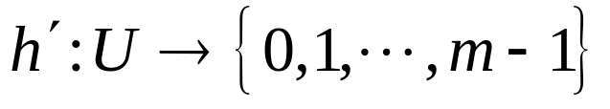
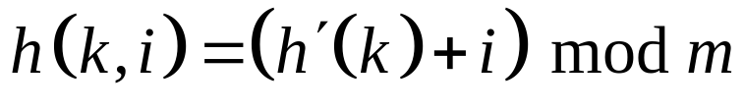
Linear probing:
  ~ an ordinary hash function (auxiliary hash function).
  .

Slide 24
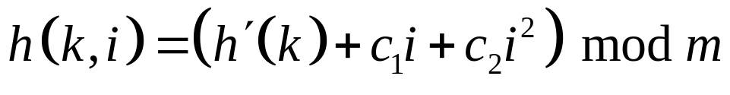
Quadratic probing:
  ,where h’ is an auxiliary hash function, c₁ and c₂≠0 and are constants.

Slide 25
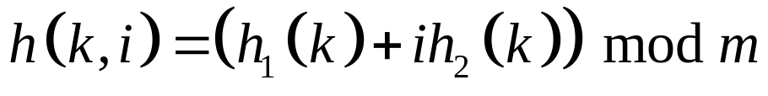
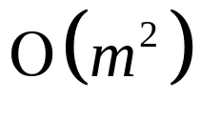
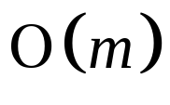
Double hashing:
  ,where h₁ and h₂ are auxiliary hash functions.
  probe sequences; Linear and Quadratic have probe sequences.

Slide 26
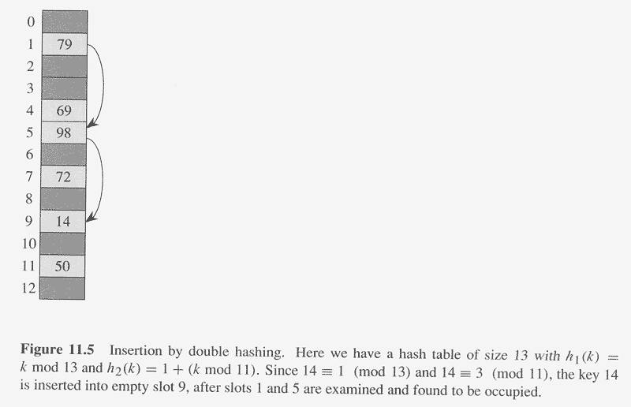
Copyright © The McGraw-Hill Companies, Inc. Permission required for reproduction or display.

Slide 27
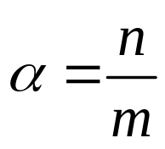
Analysis of open-addressing hashing
: load factor,
with n elements and m slots.

Slide 28
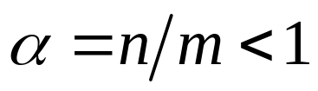
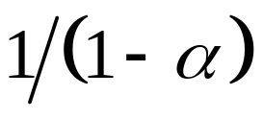
Thm:
Given an open-address hash table with load factor , the expected number of probes in an unsuccessful search is at most , assuming uniform hashing.

Slide 29
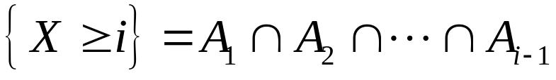
Pf:
  Define the r.v. X to be the number of probes made in an unsuccessful search.
  Define A_{i}: the event there is an ith probe and it is to an occupied slot.
  Event .

Slide 30
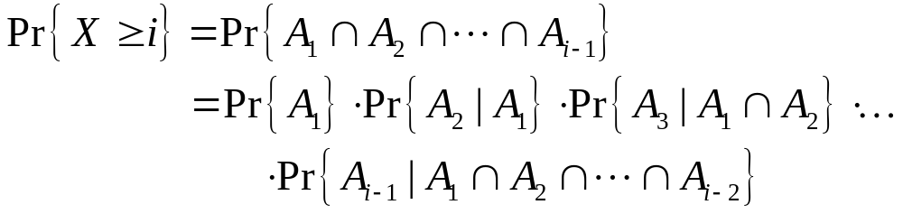
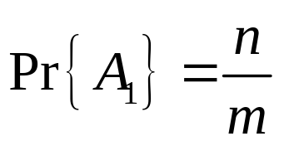
  The prob. that there is a jth probe and it is to an occupied slot, given that the first j-1 probes were to occupied slots is (n-j+1)/(m-j+1). Why?

Slide 31
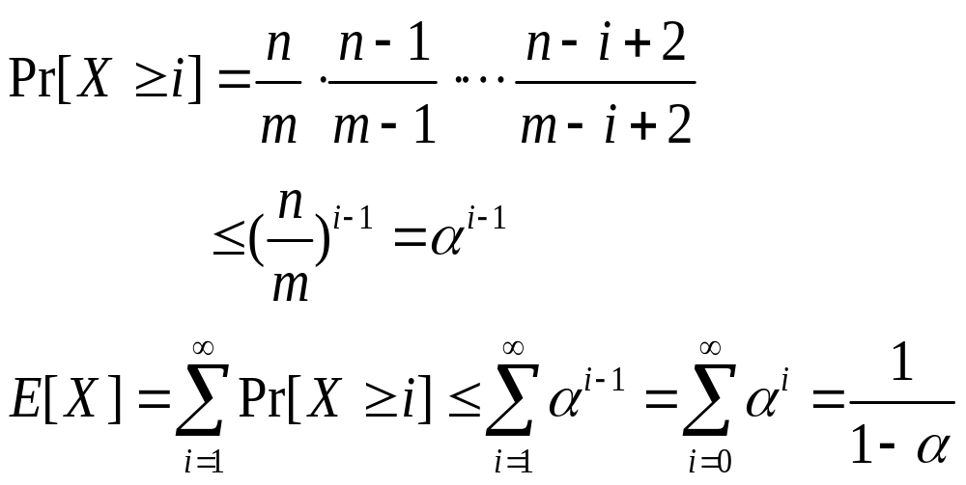
  ∵n<m, (n-j)/(m-j) ≤ n/m for all 0 ≤ j<m.

Slide 32
Cor: Inserting an element into an open-addressing hash table with load factor α requires at most 1/(1- α) probes on average, assuming uniform hashing.

Slide 33
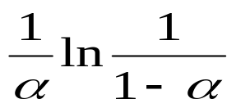
Thm: Given an open-address hash table with load factor α<1, the expected number of probes in a successful search is at most , assuming uniform hashing and that each key in the table is equally likely to be searched for.

Slide 34
Pf: Suppose we search for a key k.
If k was the (i+1)st key inserted into the hash table, the expected number of probes made in a search for k is at most
1/(1-i/m)=m/(m-i).

Slide 35
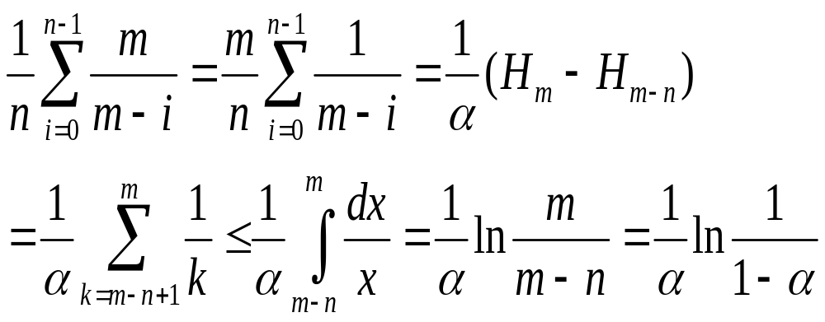
Averaging over all n keys in the hash table gives us the average number of probes in a successful search:

Slide 36
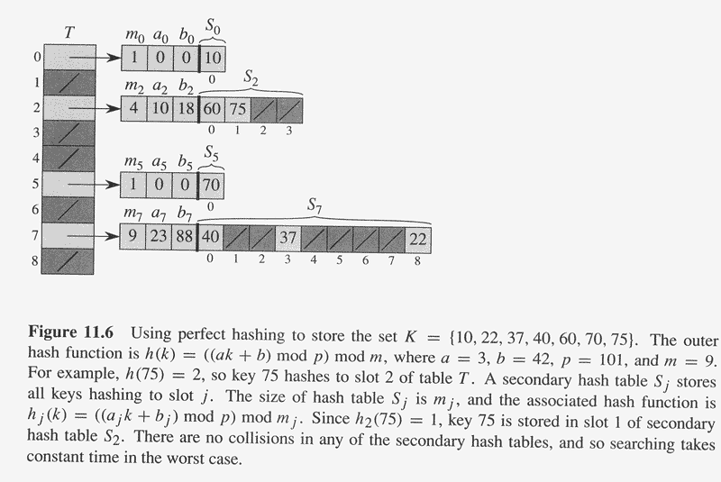
Perfect Hashing:

Slide 37
Perfect hashing :
good for when the keys are static; i.e. , once stored, the keys never change, e.g. CD-ROM, the set of reserved word in programming language.
Thm :
If we store n keys in a hash table of size m=n² using a hash function h randomly chosen from a universal class of hash functions, then the probability of there being any collisions < ½ .

Slide 38

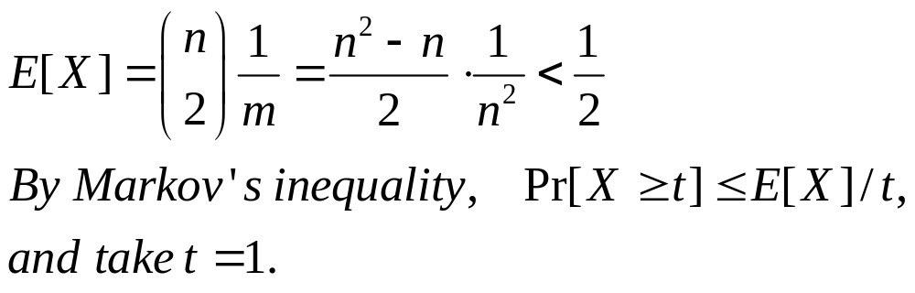
Proof:
Let h be chosen from an universal family. Then each pair collides with probability 1/m , and there are pairs of keys.
Let X be a r.v. that counts the number of collisions. When m=n²,

Slide 39
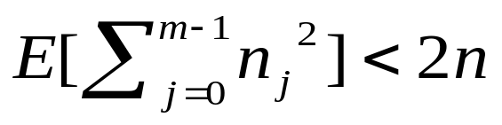
Thm: If we store n keys in a hash table of size m=n using a hash function h randomly chosen from universal class of hash functions, then , where n_{j} is the number of keys hashing to slot j.

Slide 40
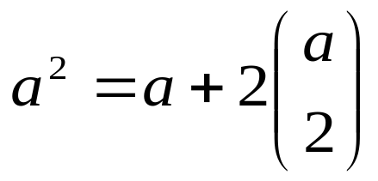
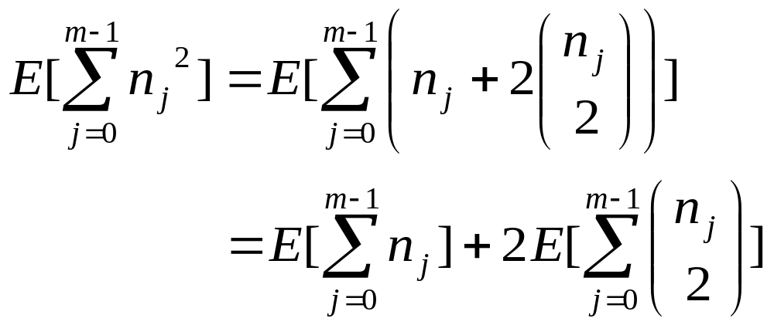
Pf:
  It is clear for any nonnegative integer a,

Slide 41
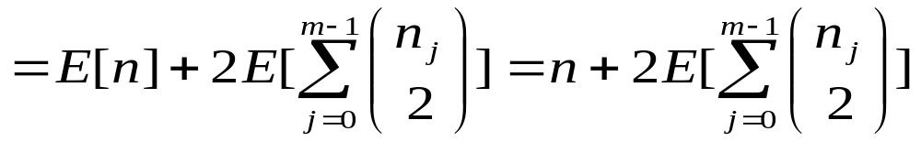
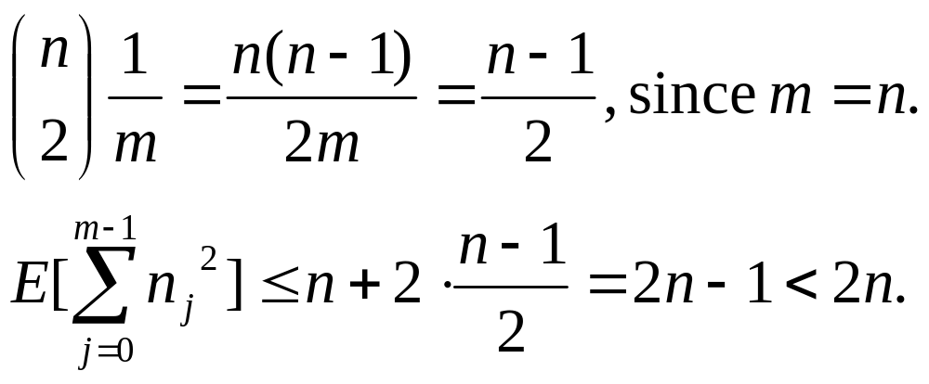
total number of collisions

Slide 42
Cor: If store n keys in a hash table of size m=n using a hash function h randomly chosen from a universal class of hash functions and we set the size of each secondary hash table to m_{j}=n_{j}² for j=0,…,m-1, then the expected amount of storage required for all secondary hash tables in a perfect hashing scheme is < 2n.

Slide 43
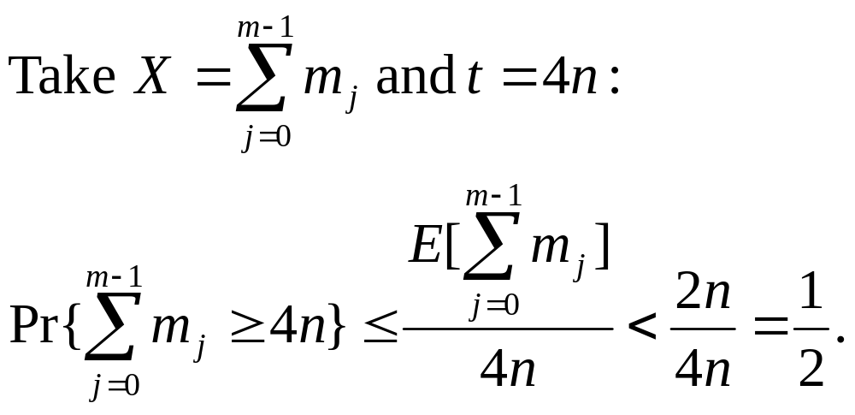
Cor: Same as the above,
Pr{total storage ≥ 4n} < 1/2
Pf:
  By Markov’s inequality, Pr{ X ≥ t } ≤ E[X]/t.

